Slide 1
State Pattern
An example not about scanning☺

Slide 2
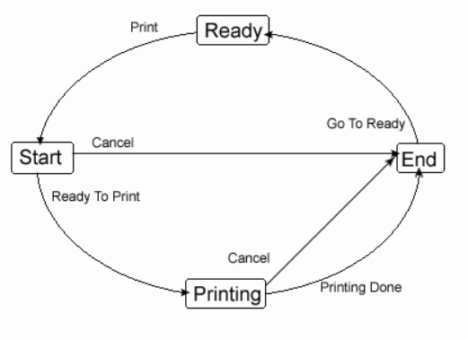
State Diagramme (From: http://www.go4expert.com/forums/showthread.php?t=5127)

Slide 3
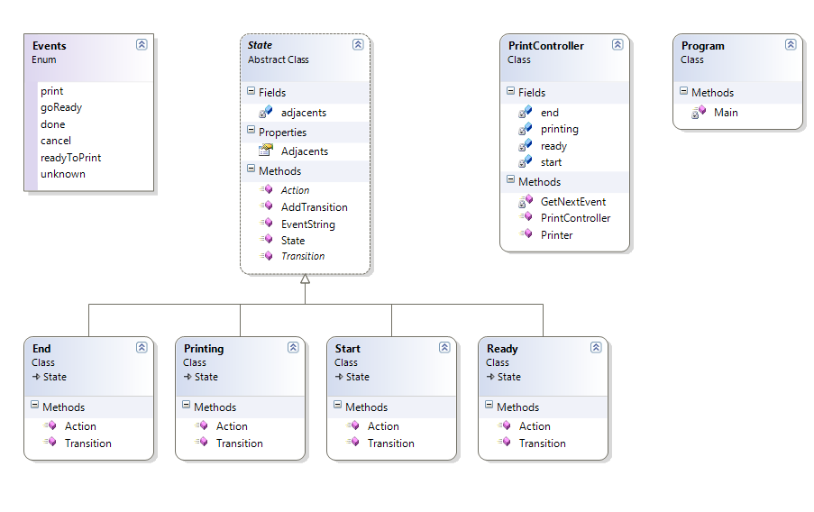
Class Diagramme

Slide 4
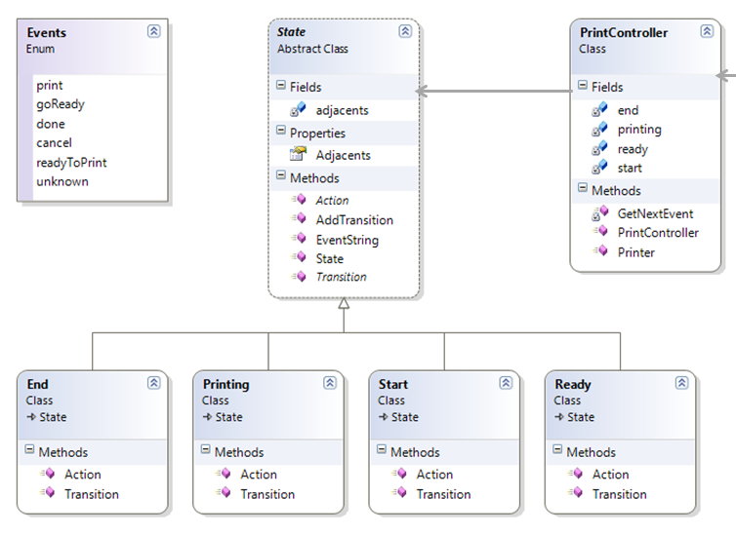

Note how the design reflects the structure of the state machine
View source
Exercise: Add a new event: “Paper Jam”, which can occur in the state “Printing” and brings the printer in an error state where it remains stopped.

Slide 5
Paper Jam
Error

